Slide 1

Predicting Bitcoin Prices Using Machine Learning
A Comparative Study of Various Models

Slide 2
Introduction
Overview: Bitcoin’s rise has revolutionized the financial world, but its price volatility presents a challenge for investors and businesses. Bitcoin's price fluctuates a lot, creating both opportunities and risks.
Eg. companies like Tesla have adopted Bitcoin as part of their treasury reserves
Research Focus:
Assess Bitcoin price’s relationship with macroeconomic variables.
Compare machine learning models: Linear Regression, Decision Trees/Random forest, Support Vector Machines (SVM), and Long Short-Term Memory (LSTM).

Slide 3
Why Bitcoin Price Prediction Matters
Bitcoin's Growing Impact:
The cryptocurrency market's market cap is now over a trillion dollars. Bitcoin holds the largest market share.
Bitcoin’s price movements can significantly impact global financial markets.
Use Cases for Accurate Prediction:
Portfolio diversification: Bitcoin as a store of value, protection against inflation.
Risk management for businesses using Bitcoin.

Slide 4
What Affects Bitcoin's Price
Bitcoin's price is influenced by supply and demand, with its value dependent on belief in its worth and future price expectations
With a fixed supply of 21 million coins, scarcity may drive up prices as it approaches the limit, assuming demand remains strong
Bitcoin's supply decreases over time, halving every four years, but past trends are not guaranteed to predict future price movements
The price will rise if demand exceeds supply
will fall on the other side
Notes:
Bitcoin's price, like other currencies and products, is influenced by supply and demand. Its value depends on people's belief in its worth and expectations of future price increases. With a fixed supply of 21 million Bitcoins, as it gets closer to this limit, the price should theoretically rise due to scarcity, assuming demand remains strong. Bitcoins are mined at a decreasing rate, with the supply halving every four years. While past trends suggest a potential price increase, there's no certainty that the market will behave the same way. Bitcoin’s price will continue to rise if demand outpaces supply, but if demand drops, the price will fall.

Slide 5
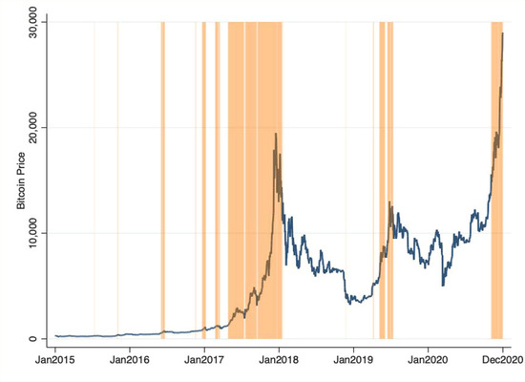
External Factors Influencing Bitcoin
Macroeconomic Indicators: Interest rates, inflation, Treasury yields, etc., can drive Bitcoin prices.
In times of economic uncertainty, Bitcoin is viewed as a ‘safe-haven’ asset, similar to gold.
during periods of the pandemic, Bitcoin experienced significant price increases as investors sought assets that could retain value.

Slide 6
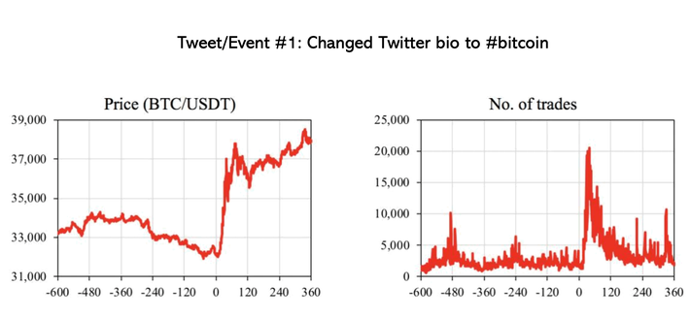
External Factors Influencing Bitcoin
Market Sentiment: Sentiment analysis from social media platforms like Twitter, Reddit, and Telegram is increasingly important in predicting Bitcoin’s price movements.
Approximately one hour after Elon Musk updated his Twitter bio to #bitcoin on January 29, 2021, Bitcoin's price surged from around $32,000 to nearly $38,000. It then dropped to about $36,000 in the following hour, likely due to profit-taking, before rising again to $38,000 in the subsequent hours. In the hours prior to Musk's bio change, Bitcoin trading was averaging fewer than 5,000 trades per hour. However, in the 60 minutes after the bio update, trading activity soared to over 20,000 trades before gradually returning to its typical range.

Slide 7
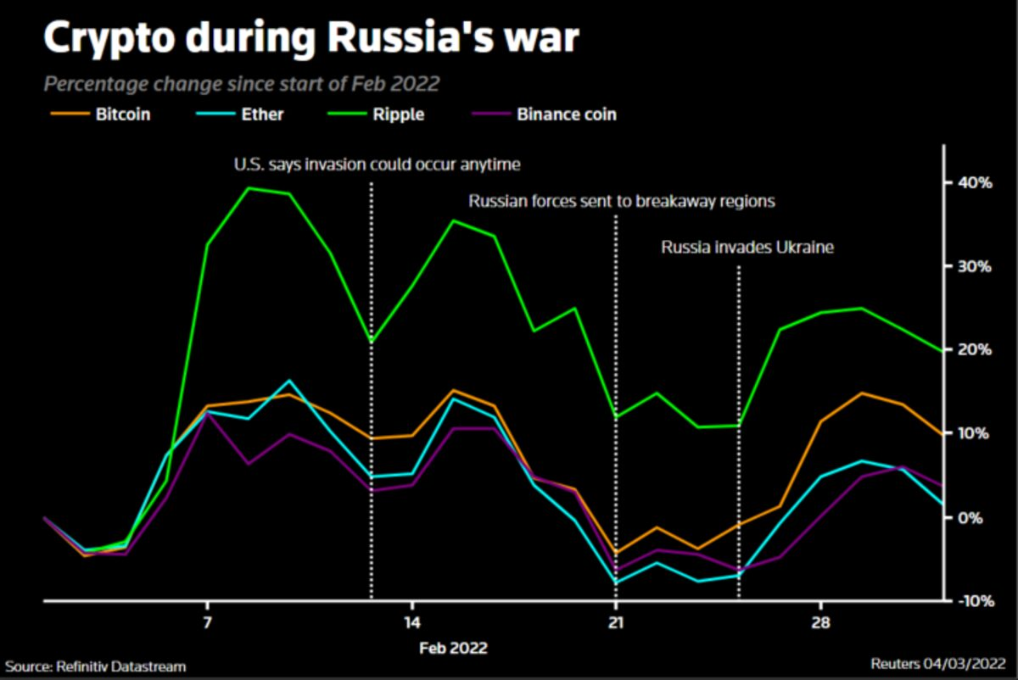
External Factors Influencing Bitcoin
Geopolitical Events & Regulations: Legal developments, regulations, and market changes can lead to drastic price swings.
Example:

Slide 8
Literature Review
Overview of Existing Research:
Mishra & Kaur (2024): Found that models like SVM, RNN, and LSTM were effective in predicting Bitcoin price but noted limitations in predicting outside historical ranges.
Chen (2023): Demonstrated the effectiveness of Random Forest in Bitcoin prediction despite limitations like the inability to predict beyond historical price peaks.
Challenges in Prediction:
Bitcoin's price is influenced by many external factors (macroeconomics, social media sentiment, regulations).

Slide 9

Machine Learning Models
Linear Regression:
A simple statistical model used to predict future values based on historical data.
Limitations: Struggles with complex, non-linear patterns.
Use Case: Helpful for baseline comparisons.
Decision Trees & Random Forests:
Decision Trees: Create a model based on sequential decision-making.
Random Forests: Ensemble of decision trees to improve accuracy and avoid overfitting.
Advantages: Robust in handling both numerical and categorical data.

Slide 10
Machine Learning Models
Support Vector Machines (SVM):
Description: Works well for classification and regression tasks.
Key Benefit: Handles high-dimensional data well.
Long Short-Term Memory (LSTM):
Description: A type of recurrent neural network, good for time-series forecasting.
Benefit: Models long-term dependencies, crucial for financial time-series prediction.

Slide 11

Methodology Overview
Supervised Learning: Focus on predicting Bitcoin price using historical data and macroeconomic indicators.
Data Collection:
Historical Bitcoin prices obtained from Yahoo Finance.
Macroeconomic indicators like exchange rates, stock market indices, etc.
Data preprocessing using Python libraries (pandas, NumPy).
Data Preprocessing:
Handling Missing Values: Forward filling, interpolation, or removal.
Exploratory Data Analysis (EDA): Visualize Bitcoin price trends, correlations with external factors.

Slide 12
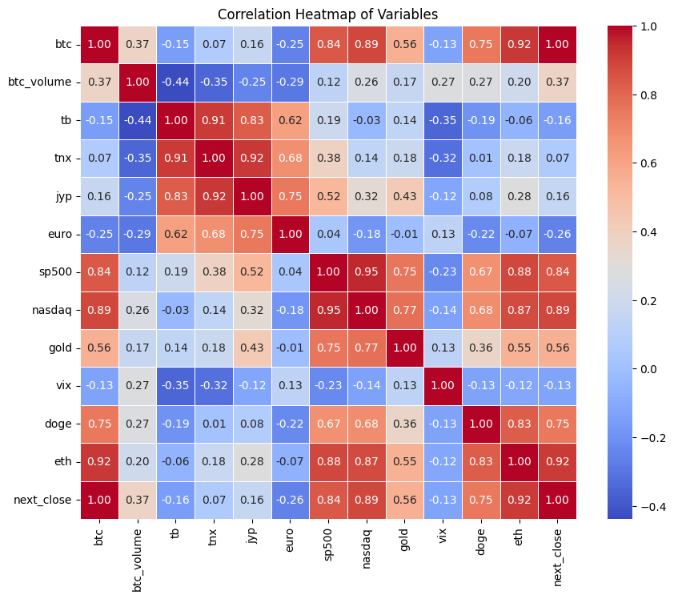
Feature Importance & Heatmap
Feature Importance: The Bitcoin price from the previous day had the greatest impact on predictions.
Heatmap: Shows correlations between variables (e.g., Bitcoin price, stock market indices, exchange rates).
Interpretation: Look for strong correlations between Bitcoin and external factors like stock market, and altcoin prices.

Slide 13
Model Selection & Approach
Model 1: Linear Regression:
Used for simple linear relationships.
Provides a baseline for comparison.
Model 2: Random Forest:
Ensemble learning model that improves accuracy by combining several decision trees.
Model 3: SVM:
Handles non-linear data by utilizing different kernels.
Model 4: LSTM:
Used for capturing sequential patterns over time, essential for time-series data like Bitcoin’s price history.

Slide 14
Training and Testing
Data Splitting:
Training set: 70% of the data.
Test set: 30% of the data.
Hyperparameter Tuning:
Random Forest: Tune the number of trees, tree depth, and sample size per leaf.
SVM: Kernel functions, regularization parameters.
LSTM: Number of layers, neurons per layer, learning rate.
Cross-Validation: K-fold cross-validation for model robustness.

Slide 15
Evaluation Metrics
Root Mean Squared Error (RMSE):
Measures the average magnitude of errors.
Lower RMSE indicates better prediction accuracy.
R-squared (R²):
Indicates how much variance in the target variable is explained by the model.
Higher R² values show better model performance.
Mean Absolute Error (MAE):
Provides the average of absolute prediction errors.
Lower MAE values indicate a model’s accuracy.

Slide 16
Results & Model Comparison
Performance Summary:
Linear Regression: RMSE = 0.2734, R² = 0.9231, MAE = 0.1875.
Random Forest: RMSE = 0.1053, R² = 0.9886, MAE = 0.0561.
SVM: RMSE = 0.1360, R² = 0.9809, MAE = 0.0919.
LSTM: RMSE = 0.6052, R² = -0.6052, MAE = 0.3335.
Conclusion:
Random Forest outperforms all models in terms of accuracy and robustness.

Slide 17
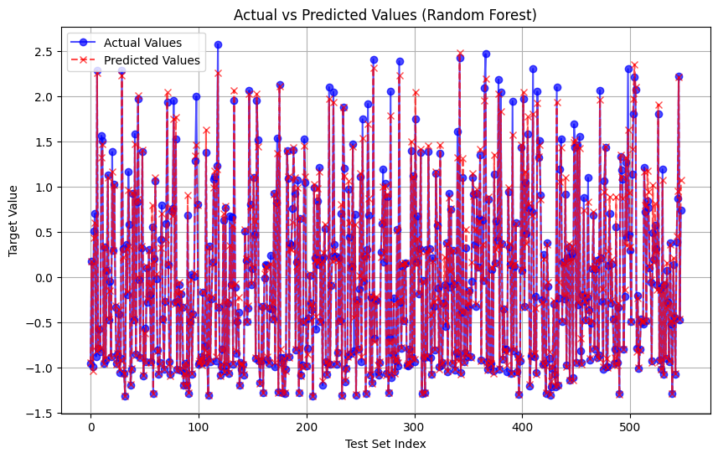
Visualizing Predictions vs Actual Prices

Slide 18
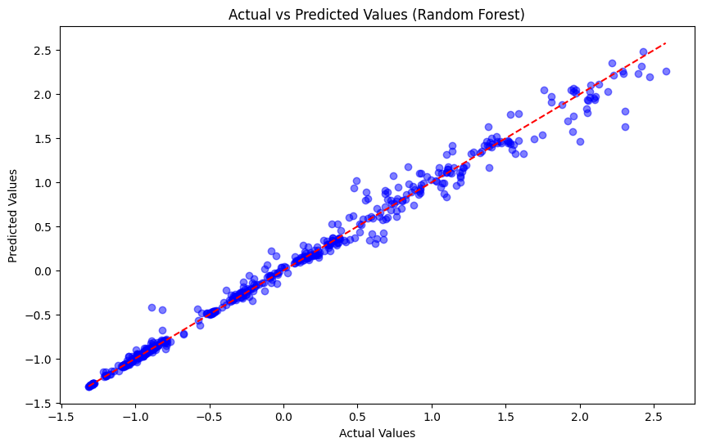
Visualizing Predictions vs Actual Prices

Slide 19
Challenges & Limitations
LSTM Limitations:
May not have enough temporal patterns for short-term Bitcoin price prediction.
Requires significant computational resources.
External Factors:
Market sentiment, geopolitical events, and regulations were not captured in the analysis.
Future models could integrate sentiment analysis from social media.

Slide 20
Challenges with LSTM Model Performance
LSTM Model Underperformance:
Despite other models performing well, the LSTM model showed negative R², indicating poor predictive performance.
Model Architecture:
Underfitting/Overfitting: A simple architecture might not capture complex patterns, while a too-complex one could overfit the training data.
Insufficient Layers or Units: The number of layers and units might not have been optimal, leading to poor learning capacity.

Slide 21
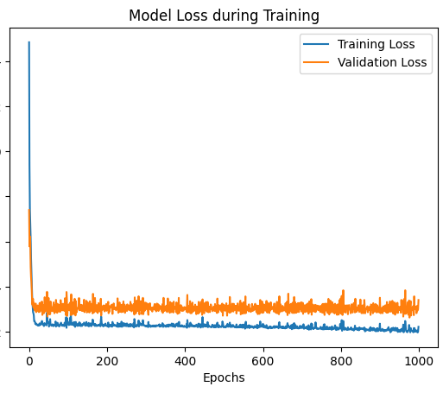
LSTM model loss
The validation loss doesn’t improve much after the initial few epochs. The validation loss is quite similar to the training loss, and it stays relatively high.
This could be a sign of underfitting, where the model isn't complex enough to learn the patterns in the data effectively.

Slide 22
Conclusion
Key Findings:
Random Forest performed best across all evaluation metrics.
LSTM, while powerful for time-series, was not optimal in this study with relatively small dataset.
Future Work:
Integration of External Factors: Investigate the impact of external factors such as social media sentiment, regulatory news, and macroeconomic indicators on cryptocurrency price predictions. This would provide a more comprehensive view of market movements beyond traditional market data.
Advanced Sentiment and Multimodal Analysis:
Leverage sentiment analysis alongside multimodal approaches (incorporating text, audio, and visual data) to refine predictions. By combining insights from diverse data sources, we can improve the model’s ability to understand market sentiment and fluctuations.
Exploring Alternative Machine Learning Models: Expand beyond popular models like LSTM and Random Forest by exploring other advanced techniques such as Transformer-based architectures (e.g., BERT, GPT), reinforcement learning, and ensemble methods. These models can enhance performance in terms of generalization and adaptability to market dynamics.
Real-time Data Integration: Implement real-time data pipelines that continuously feed new information into the model, allowing for more accurate and timely predictions. This would include not only financial data but also news articles, social media updates, and market sentiment.

Slide 23
References
Chen, J. (2023). Analysis of Bitcoin Price Prediction Using Machine Learning. Risk Financial Manag. 2023, 16, 51. https://doi.org/10.3390/jrfm16010051
Mishra, A., & Kaur, P. (2024). Cryptocurrency price prediction analysis using machine learning algorithms. SSRN Electronic Journal. https://doi.org/10.2139/ssrn.4490209
Coleman, B., Merkley, K., & Pacelli, J. (2022). Human versus machine: A comparison of robo-analyst and Traditional Research Analyst Investment Recommendations. The Accounting Review, 97(5), 221–244. https://doi.org/10.2308/tar-2020-0096
Kim, H., Bock, G., & Lee, G. (2021). Predicting Ethereum prices with machine learning based on Blockchain information. Expert Systems with Applications, 184, 115480. https://doi.org/10.1016/j.eswa.2021.115480
Abraham, J., Higdon, D., Nelson, J., & Ibarra, J. (2018). Cryptocurrency price prediction using tweet volumes and sentiment analysis. SMU Data Science Review, 1(3), 1. https://scholar.smu.edu/cgi/viewcontent.cgi?article=1039&context=datasciencereview
Kraaijeveld, O., & De Smedt, J. (2020). The predictive power of public Twitter sentiment for forecasting cryptocurrency prices. Journal of International Financial Markets Institutions and Money, 65, 101188. https://doi.org/10.1016/j.intfin.2020.101188
Valencia, F., Gómez-Espinosa, A., & Valdés-Aguirre, B. (2019). Price movement prediction of cryptocurrencies using sentiment analysis and machine learning. Entropy, 21(6), 589. https://doi.org/10.3390/e21060589

Slide 24
END

